Slide 1
Homework 01
Samuel Swain (SMS5736)

Slide 2
Data
Chart Information
Patient demographics (e.g. age, gender, race, ethnicity, contact information)
Medical encounters (e.g. initial consultations, follow-up visits, procedures)
Developmental history (e.g. growth charts, developmental milestones)
Current and past medications
Medication, food, and other allergies
Active problems/diagnoses
History of present illness (HPI)
Physical examination (including vital signs)
Results of medical tests and imaging studies
Patient History
History of present illness (HPI)
Past medical history (PMH)
Past surgical history (PSH), including surgery dates and reports
Family history (e.g. history of certain conditions or diseases in family members)
Social history (e.g. occupation, family situation, habits such as smoking or exercise)
Immunizations and dates
Data Updates
Chart information will be updated on visit if possible (i.e. physical examination will be updated if performed)
Patient History will be updated on visit as it is all history kept of patient

Slide 3
Data Sources & Types
Demographic Data: **EHRs**
Medical Data: **EHRs**, Healthcare Cost and Utilization Project (HCUP) data, clinical trial data
Patient History Data: **EHRs**, **medical claims data**, **health questionnaires**
Social Determinants of Health Data: **NACCHO resources**
Patient-Generated Data: FDA guidance on digital health technologies, PCHA resources
Public Health Data: CDC data on infectious diseases, chronic diseases, **WHO data on health equity**, non-communicable diseases, and environmental health
Demographic Data:
Census: CSV, JSON, Excel
EHRs: HL7, XML, FHIR
Medical Data:
HCUP: CSV, SAS, Excel
Clinical Trials: CDISC, CSV, XML
CPT Codes: CSV, Excel
EHRs: HL7, XML, FHIR
Patient History Data:
EHRs: HL7, XML, FHIR
Claims: X12, CSV, Excel
Questionnaires: CSV, Excel, PDF
Social Determinants:
NACCHO: CSV, Excel, PDF, GIS
WHO: CSV, Excel, XML, JSON
Patient-Generated Data:
FDA: PDF, HTML
PCHA: PDF, HTML, XML, JSON
Public Health Data:
CDC: CSV, Excel, JSON, GIS
WHO: CSV, Excel, XML, JSON, GIS
**: Focusing the rest of the assignment on

Slide 4
Analytics
Descriptive Analytics
Analyze patient demographics and disease prevalence to understand the population's health status. (Frequency: Monthly)
**Evaluate hospital admission and discharge rates, lengths of stay, and readmission rates. (Frequency: Monthly)**
Analyze treatment patterns and medication usage to identify best practices. (Frequency: Monthly)
Diagnostic Analytics
Identify patterns and correlations between patient characteristics and health outcomes. (Frequency: On Demand)
**Analyze data to determine factors contributing to hospital readmissions or complications. (Frequency: Monthly)**
Investigate the causes of variations in treatment outcomes and care quality. (Frequency: Monthly)
Predictive Analytics
Develop models to predict disease progression or patient risk based on clinical and demographic factors. (Frequency: Yearly)
Forecast healthcare resource utilization, such as hospital bed or staff requirements. (Frequency: Weekly)
**Predict if patient will be readmitted to hospital. (Frequency: On-Demand)**
Prescriptive Analytics
Recommend personalized treatment plans based on patient-specific factors and historical data. (Frequency: On Demand)
Optimize resource allocation, such as staff scheduling or patient triage, to improve care quality and efficiency. (Frequency: Weekly)
Suggest interventions to improve patient outcomes and prevent complications or readmissions. (Frequency: On-Demand)
**: Focusing the rest of the assignment on

Slide 5







Cloud Services
Data Ingestion:
S3: Used as an input for raw data. Basic data lake.
Data Warehousing:
RedShift: Needed to store extracted text and predictions. RedShift because of large scale (40+ TB)
Data Storage and Data Processing:
S3: Needed to store extracted text and predictions.
Lambda: Needed to process data at multiple steps.
SQS: Needed to queue new items. Passing it to the lambda functions
Textract: Needed to extract text from documents
Business Intelligence and Analytics:
QuickSight: Needed to build dashboards using the data in RedShift
Data Science:
SageMaker: Needed to train and deploy the machine learning model
S3: Needed to store model artifacts after training
Applications:
SageMaker: Needed for model deployment. Using the SageMaker endpoint API to seamlessly deploy the model.

Slide 6
Data Sizing
EHR Data
500,000 Patients
Assuming 80 MB per user per year [1]
Public Health Data
WHO data on health equity:
Assuming about 50 related datasets at 2.5MB each
Questionnaires
500,000 Patients
Assuming one filled out per visit per patient
Assuming 10 KB; the size of a one page word doc
Assuming 40.5 per 100 people visit per year [2]
Medical Claims
500,000 Patients
Assuming 700 KB file size per claim
Assuming 50% of visits result in a claim
Assuming 40.5 per 100 people visit per year [2]
40 TB Per Year
125 MB
2.025 GB Per Year
141.75 GB Per Year
Total: 40.1439 additional terabytes/year

Slide 7
Capacity Sizing
Assumptions
Training will take two weeks using the best SageMaker instance
Half of all data collected is unable to be transferred into RedShift
AWS SageMaker: 1 ml.p2.16xlarge Instance, 1 Endpoint
AWS S3: 41 TB Storage
AWS RedShift: 20 TB Storage, ra3.4xlarge @ 100%/month
AWS Lambda: 4096 MB enough for processing

Slide 8
Cost Estimate / Assumptions
Assumptions (Building on assumptions from previous slides)
Lambda:
- Document processing: 500,000 * 0.405 * .5 / 12 = 8437.5 * 2 requests/month
- Data preprocessing: 500,000 * 0.405 / 12 = 16875 requests/month
- Prediction Processing: 500,000 * 0.405 / 12 = 16875 requests/month
- Processing time: 50 MS
- Memory Allocated: 4096 MB
S3:
- In operation for 1 year: 41 TB of data
- PUT, COPY, POST, LIST requests: (8437.5 * 2 + 16875 + 16875 + 16875) * 2 = 135000 requests/month
SQS:
- Data Preprocessing: 500,000 * 0.405 * .5 / 12 = 16875 requests/month
- Prediction Processing: 500,000 * 0.405 / 12 = 16875 requests/month
RedShift:
- In operation for 1 year: 20 TB of data
- ra3.4xlarge at 100%/utilization/month sufficient
- 20/12 = 1.666 TB transfer to per month
SageMaker:
- Two weeks training on an ml.p2.16xlarge instance is sufficient for training model (10 GB Model)
- API Endpoint: 500,000 * 0.405 / 12 = 16875 requests/month
- 3 Data Scientists, 1 notebook per @ 4 hours/day 22 days/month
QuickSight:
- 3 Business Analysts
- Session #: 50 Readers, 30 working days, 100% of readers are active all the time
Textract:
- Document processing: 500,000 * 0.405 * .5 / 12 = 16875 requests/month
EventBridge:
- 1 scheduled event per month
Cost Estimate & Link: $125,566.98 / Year
https://calculator.aws/#/estimate?id=4030aeee68bef5d2bf2c5284a40eee2780c6d0f6

Slide 9
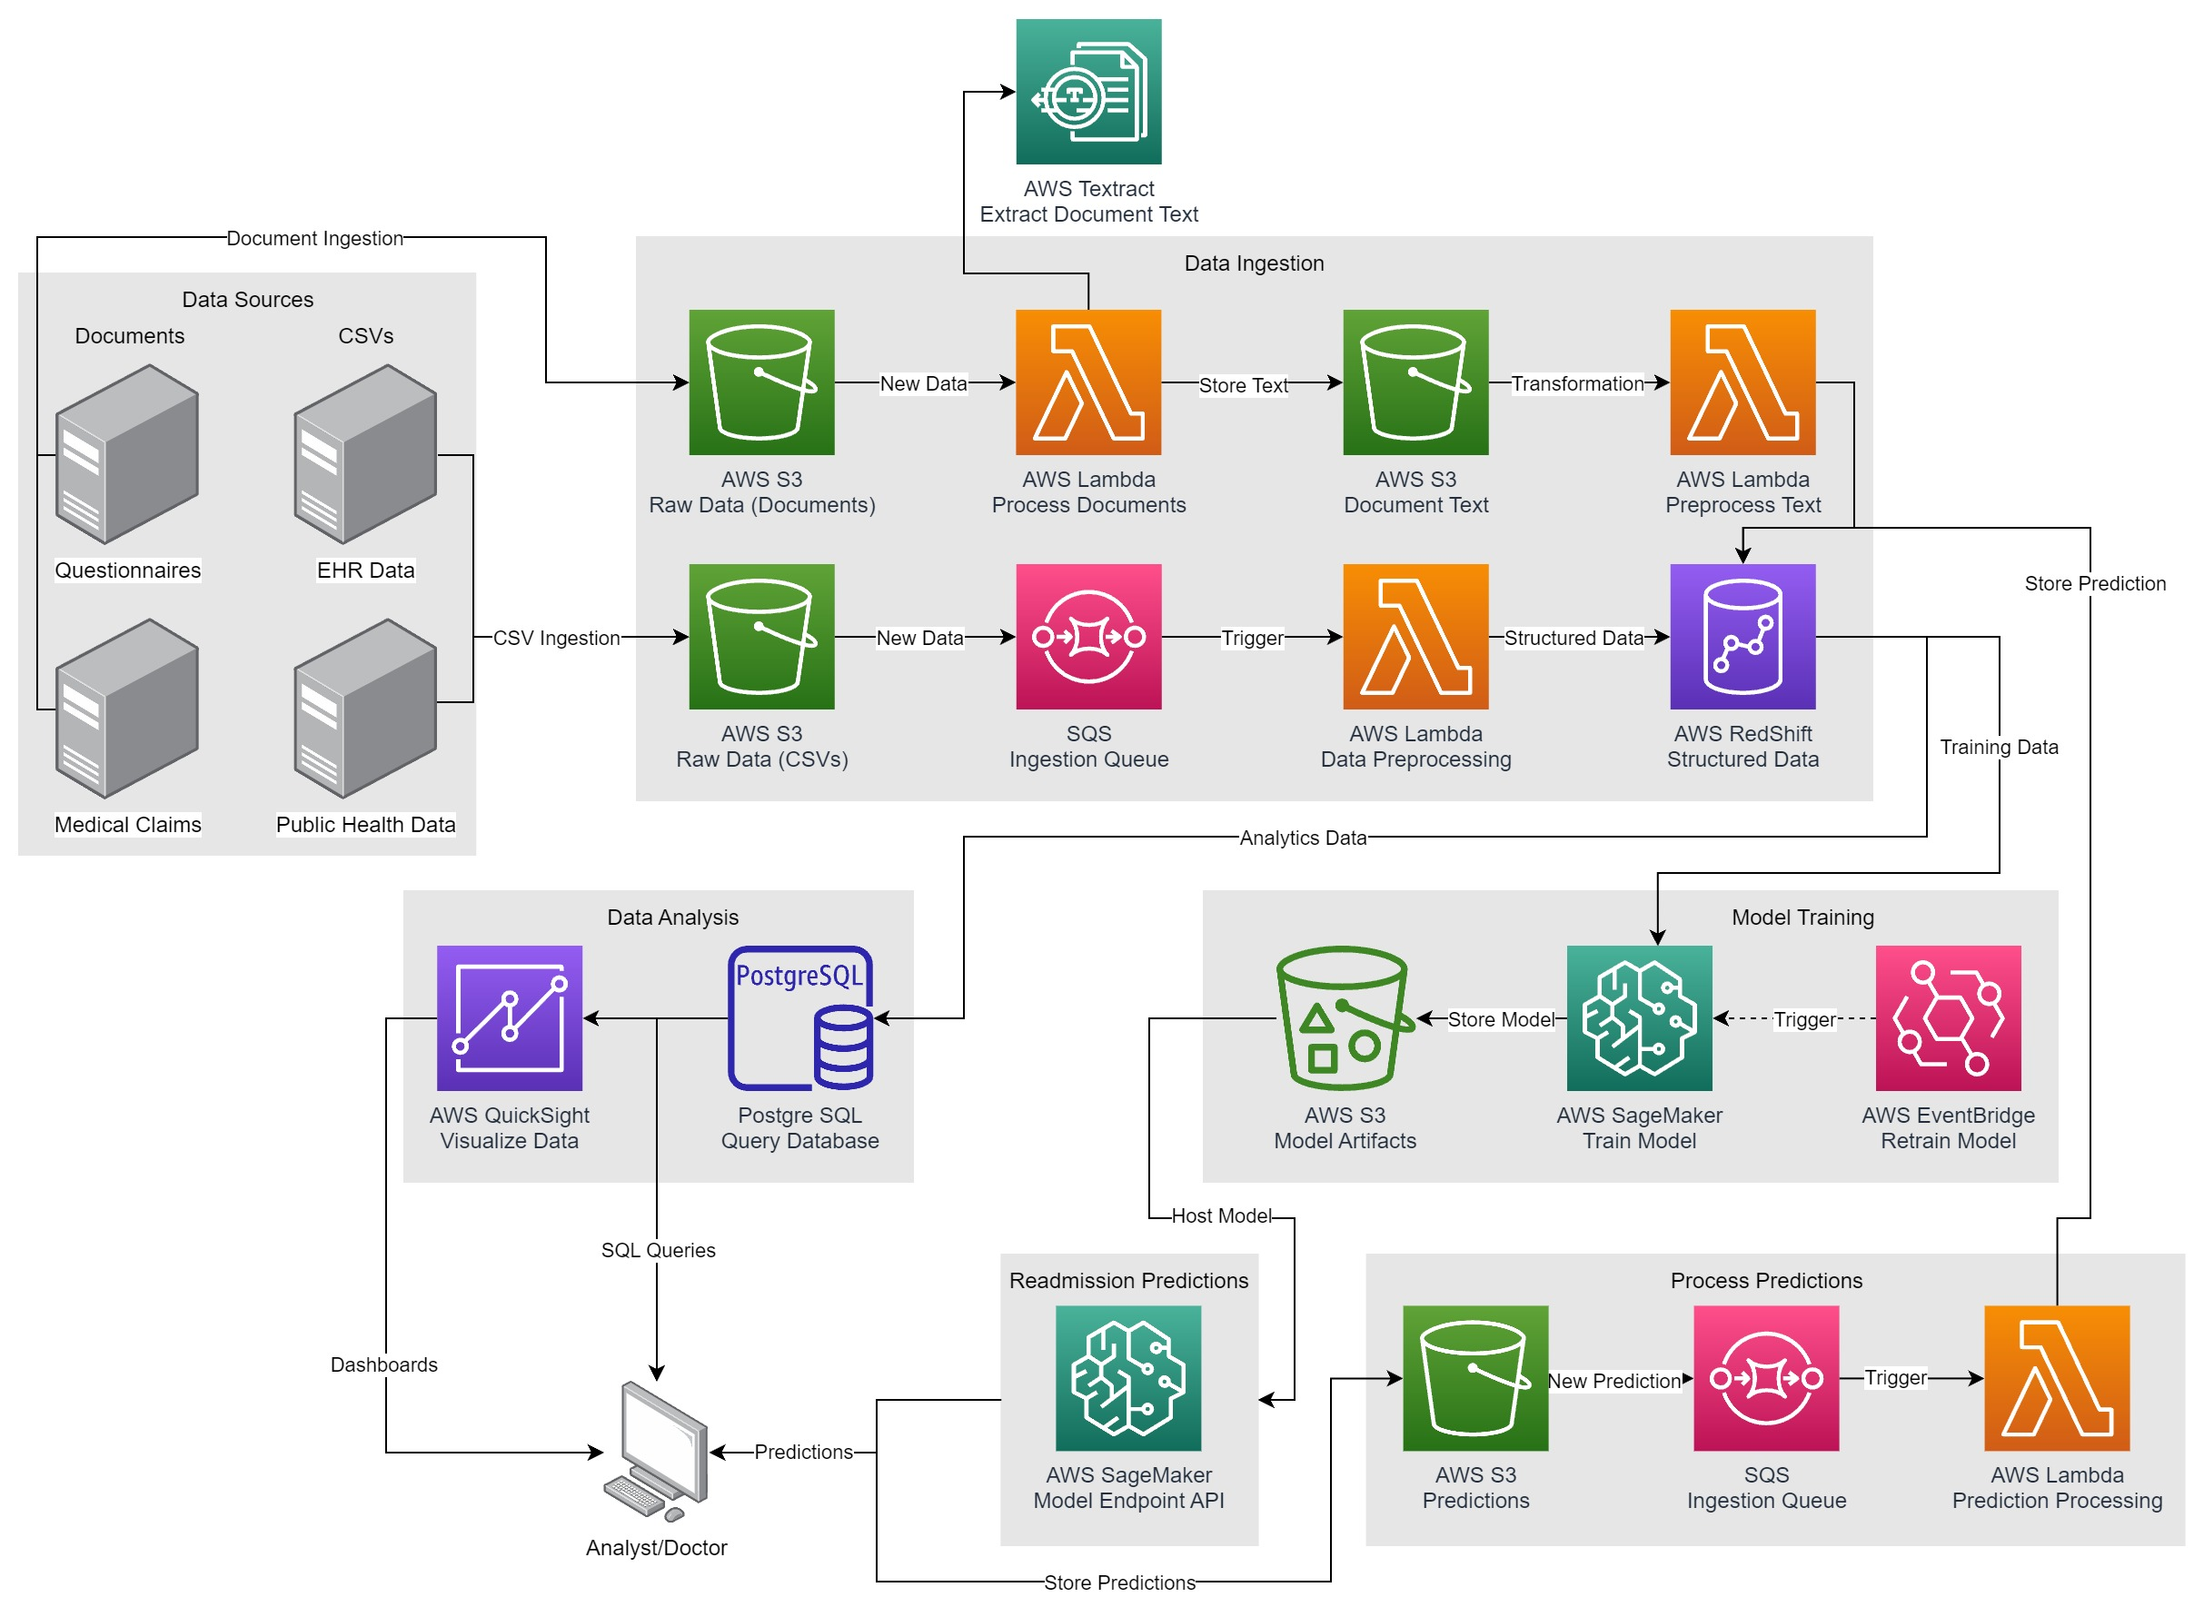
System Architecture Diagram

Slide 10
References
1. https://www.harmonyhit.com/health-data-volumes-skyrocket-legacy-data-archives-rise-hie/
2. https://www.cdc.gov/nchs/fastats/emergency-department.htm
3. https://www.sampleforms.com/medical-claim-form.html

